Slide 1
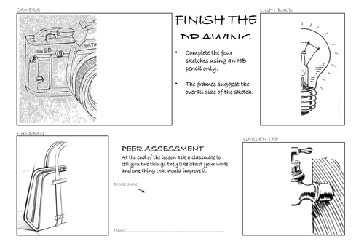
Complete the four sketches using a pencil or pen only
The frames suggest the overall size of the sketch
In these drawings, the outline is more important than the shading. Once you have an accurate outline, then you can start adding shading

