Slide 1
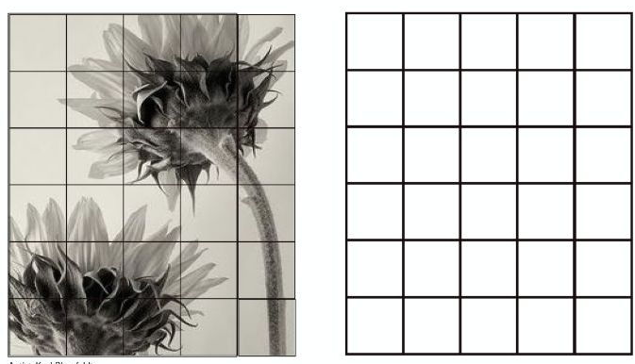
NATURAL FORM GRID DRAWING: ADD TONE & SHADING

Slide 2
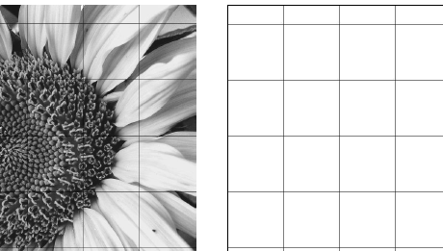

Slide 3
