Slide 1
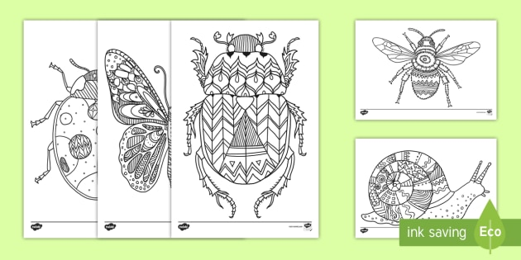
ZECTANGLE BUGS… ADDING ABSTRACT PATTERNS & SHAPES TO BUGS & INSECTS CAN MAKE THEM LOOK REALLY INTERESTING!

Slide 2
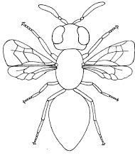
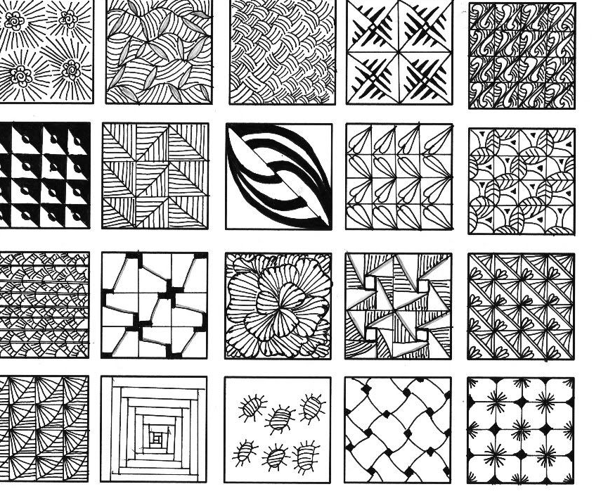
ADD YOUR OWN TRIBAL PATTERNS TO THESE INSECT OUTLINES.

Slide 3
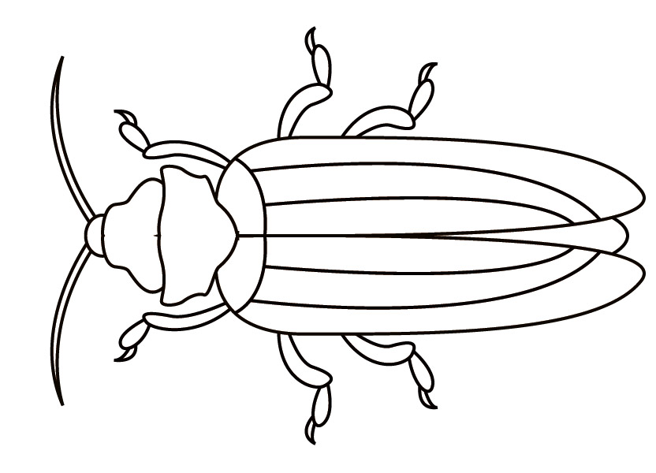
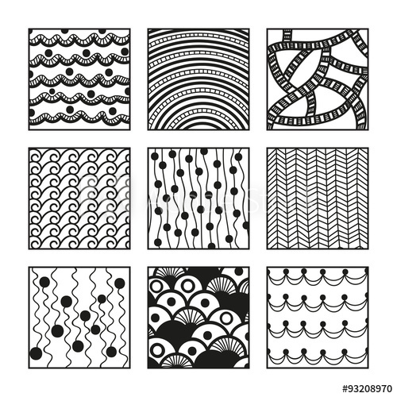

Slide 4
