Slide 1
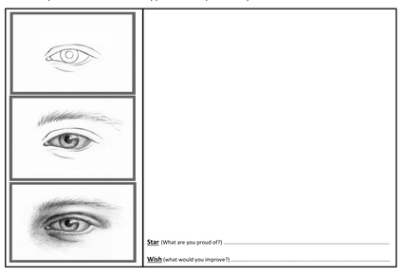
PORTRAIT DRAWING: Practice drawing eyes. Begin with an outline and then add shading

Slide 2
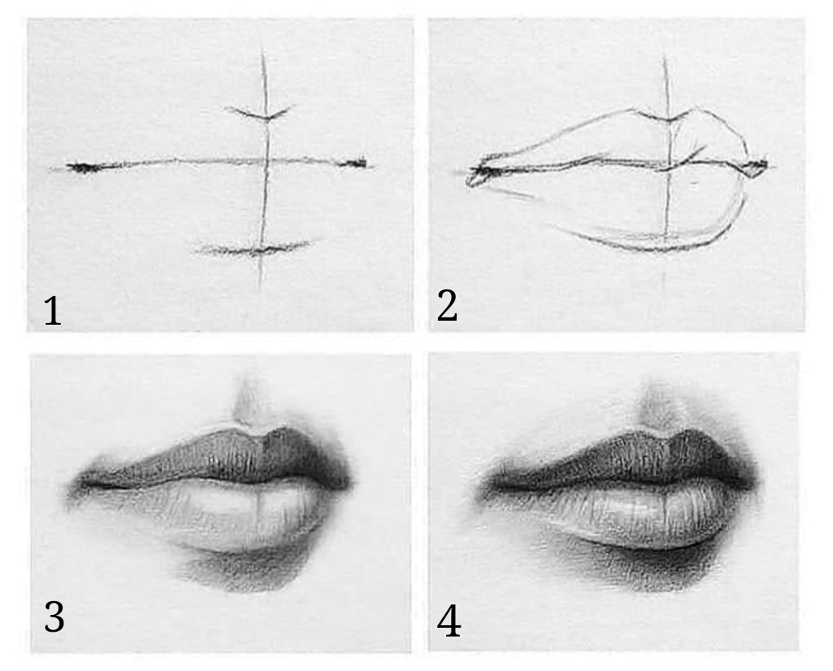
PORTRAIT DRAWING: Practice drawing lips. Begin with an outline and then add shading

Slide 3
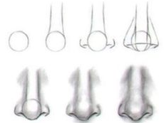
PORTRAIT DRAWING: Practice drawing nose. Follow the step-by-step guide. Begin with an outline and then add shading

Slide 4
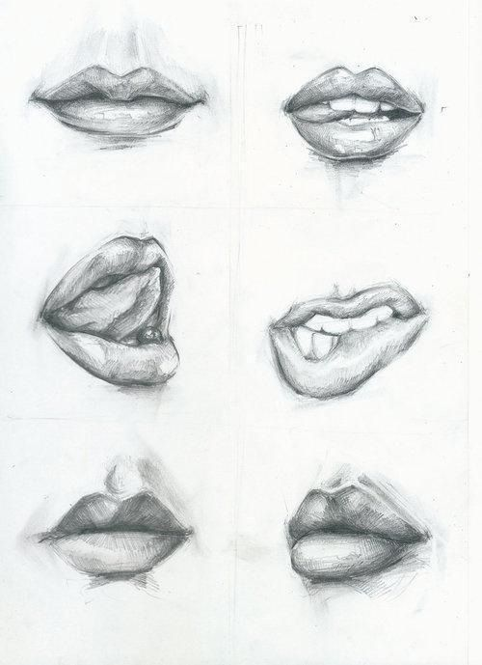
Drawing lips… Stretch & challenge activity

Slide 5
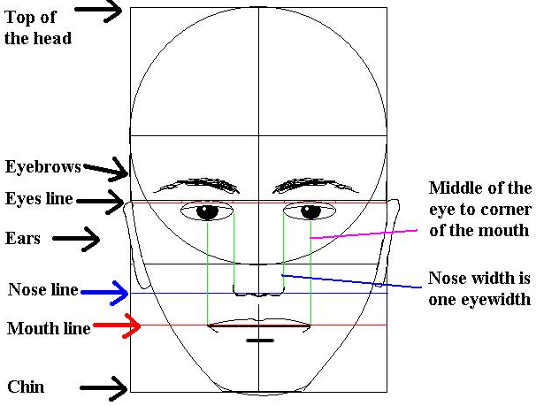
PORTRAIT DRAWING: It is really important to understand how proportion is used in portrait drawing. Please look at the measurement lines and make a note of distance between each of the facial features.

Slide 6
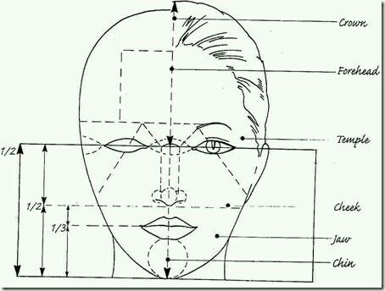
PORTRAIT DRAWING: This is a more detailed example of how proportion is used in portrait drawing…

Slide 7
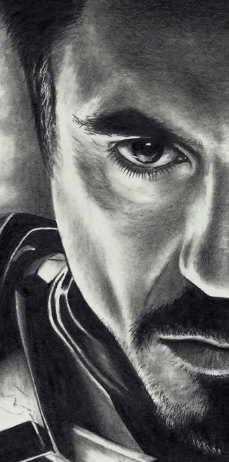
PORTRAIT DRAWING: Complete the other half of this portrait drawing. You can use measurement lines to help your drawing

Slide 8
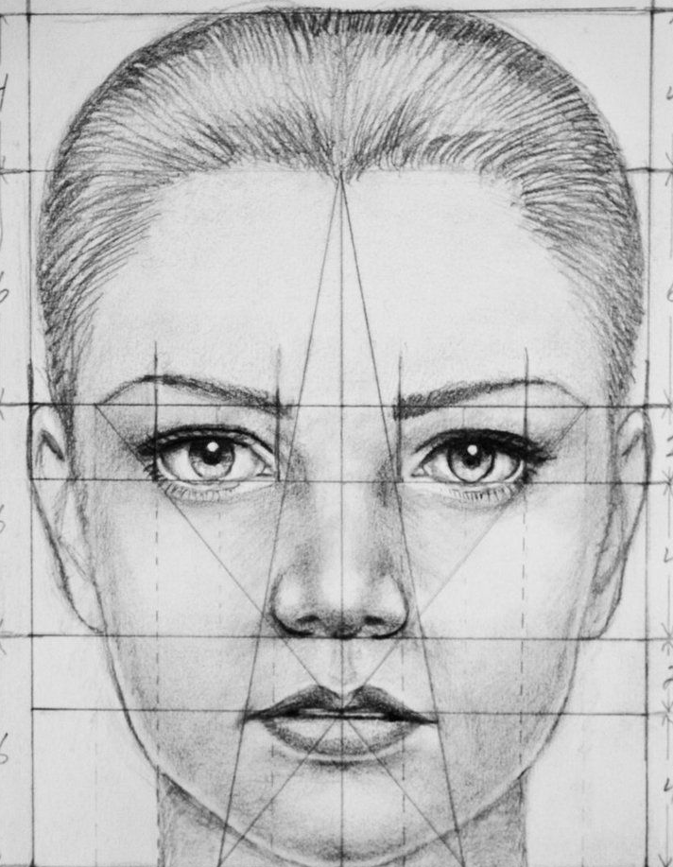
PORTRAIT DRAWING: Try to drawing this portrait using measurement/proportion lines and shading. REMEMBER: It is more important to have accurate proportion than it is to have detailed shading…

